Slide 1
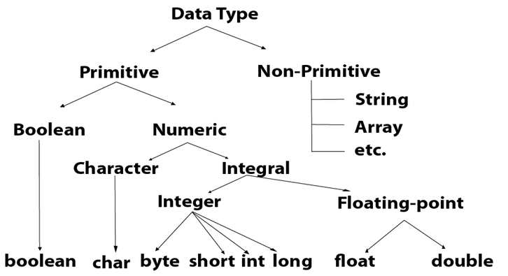
Data Types

Slide 2
Byte
Size = 1 byte = (8 bit)
Max value = +127
Min value = -128
Range = -128 to + 127
Ex:
byte b = 10;
byte b = 127;
byte b = 128;
byte b = 10.5;
Short
Size = 2 byte =(16 bits)
Range = -2(15) to 2(15)-1
[-32768 to 32767 ]
Ex:
Short s = 10000;
Short s = -5000;

Slide 3
Int
Size = 4 byte = (32 bits)
Range = -2(31) to 2(31)-1
[-2147483648 to 2147483647 ]
Ex:
Int a =100000;
Int b = - 200000;
Long
Size = 8 byte =(64 bits)
Range = -2(63) to 2(63)-1
Ex:
long l = 100000L;
long b = -200000L;

Slide 4
Float
Size = 4 byte
Range = -3.4e38 to 3.4e38
Ex:
float f = 234.5f;
Double
Size = 8 byte
Range = -1.7e308 to 1.7e308
Ex: double d = 12.3
Boolean
Size = NA
Range = NA
(true / false)
Ex: boolean b =true / false;
boolean b = 0; -→ CE

Slide 5
Boolean b = “false” --→ CE
Boolean b = True -→ CE
Char
Size = 2 bytes
Range = 0 to 65535
Ex: char c = ‘A’;

